Slide 1
SENTIMENT ANALYSIS SYTSTEM
• Sentiment Analysis on Social Media (Twitter).
• Analyze the Polarity of a all tweets in a profile.
• Analyze the Polarity of a specific topic. (for Example Apple)
• This system can be used in AI to predict human emotions, opinions and behavior.

Slide 2
PSEUDOCODE
System Start
Data Mining Tweets
Perform Sentiment Analysis
Show All Tweets/Posts
Display Polarity Values
#Search For a Particular Topic
While < len(Row[‘tweets’]) :
If SearchTopic in Tweets :
Data Mining for SearchTopic
Gather and visualize all data with Polarity Values.

Slide 3
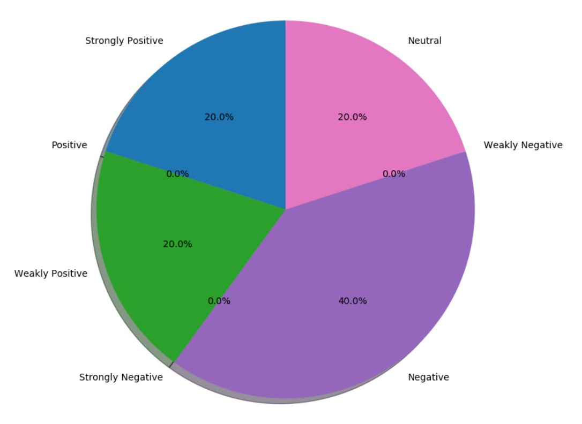
GRAPH VISUALIZATION

Slide 4
SOFTWARE SPECIFICATION
Dynamic Object-Oriented Programming Language : Python 3.7.2
Operating System : Priority 1 - Windows 10 Priority 2 – Linux
Integrated Development Environment (IDE) : Jetbrains PyCharm Community Edition 2018.3.4 It is a standalone application in which codes are used, manipulated and run.

Slide 5
COMPUTING INSTRUCTIONS
Programming Language : Python
Physical Infrastructure : Graphical User Interface through Python Tkinter
Project Tools and Dependencies : CSV - To access, save, read, write in hard drive storage. •Tweepy - Allows use of Twitter API to connect our system with Twitter Servers. •Textblob - Access the built-in Data dictionary to read user input words or tweets • Matplotlib - For Graphical Representation, using basic mathmatics and visualize with the help of a graph or pie chart. • Speech Recognition– Module used for any Input of voice.

Slide 6
SOFTWARE DEVELOPMENT PROCESS (V-MODEL):
Requirements
Operation and Maintenance
UI Design
Data Mining
Bug Fixing, Test and Verification
Sentiment System
Testing and Integration
Project Definition
Integration
Visualizations
Implementation

Slide 7
PROGRESS
Our software is closing in Technical Release State. Current Stage – AI Processing, Events Recognition
Next Stage – Complete Release

Slide 8
THANK YOU!

